Slide 1
Introduction
January 2016
Presented by Dan Keegan
Phone: 312-882-1116
Email: dan@optionthinker.com

Slide 2
Long Calls
Potentially become long UV
Risk is limited to the premium paid
Possible profit is unlimited
Time value embedded in option premium is constantly decaying
In times of uncertainty time value can actually increase with the passage of time

Slide 3
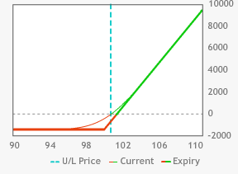
Long Calls
Buy 10 PEP Dec 100 calls @ 1.40
PEP @100.12
Breakeven point 101.40
Max loss $1,400.00
Max profit unlimited
Max profit 1K long shares unlimited
Max loss $100,120.00 on 1K long shares
Margin 1K long shares $100,120.00

Slide 4
Long Puts
Potentially become short UV
Risk is limited to the premium paid
Possible profit is continuous until UV hits zero
Time value embedded in option premium is constantly decaying
In times of uncertainty time value can actually increase with the passage of time

Slide 5
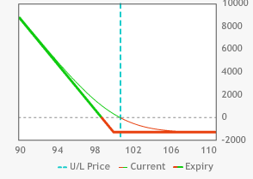
Long Puts
Buy 10 PEP Dec 100 puts @ 1.28
PEP @100.12
Breakeven point 98.72
Max loss $1,280.00
Max profit $98,720.00
Max profit 1K short shares $100,120.00
Max loss unlimited on 1K short shares
Margin 1K short shares $150,180.00

Slide 6
Long Straddle
Buy at the money (ATM) calls and puts
Potentially become either long or short underlying value (UV)
Risk is limited to the premium paid
Possible profit is unlimited to the upside and continuously increasing to the downside until UV hits zero
Time value that is embedded in both the call and put premium is constantly decaying at increasing rate
In times of uncertainty both the call and put premium can actually increase even with the passage of time

Slide 7
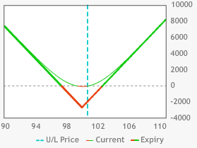
Long Straddle
Buy 10 PEP Dec 100 straddles @ 2.68
PEP @100.12
Max upside profit unlimited
Max downside profit $97,320.00
Max loss $2,680.00
Upside breakeven point (UBEP) 102.68
Downside breakeven point (DBEP) 97.32

Slide 8
Short Calls
Potentially become short the UV
Risk is unlimited to the upside
Maximum profit is limited to the premium credited
Time value embedded in option premium is constantly decaying
In times of uncertainty time value can actually increase with the passage of time

Slide 9
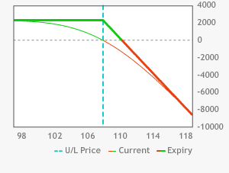
Short Calls
Sell 10 GILD Dec 108 calls @2.27
GILD @107.69
Breakeven point @110.27
Max profit $2,270.00
Max loss unlimited

Slide 10
Short Puts
Potentially become long the UV
Risk is unlimited until IV hits zero
Max profit is limited to the premium credited
Time value in option premium is constantly decaying
In times of uncertainty the time value can actually increase with the passage of time

Slide 11
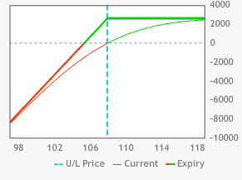
Short Puts
Sell 10 GILD Dec 108 puts @ 2.58
GILD @107.69
Breakeven point @105.42
Max profit $2,580.00
Max loss $105,420.00

Slide 12
Short Straddles
Sell ATM calls and puts
Potentially become long UV or short UV
Upside risk is unlimited and downside risk increases continuously until UV hits zero
Max possible profit is limited to the premium credited
Time value embedded in option premium is constantly decaying at an increasing rate
In times of uncertainty the time value embedded in the option premium can actually increase with the passage of time

Slide 13
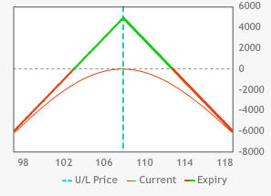
Short Straddles
Sell 10 GILD Dec 108 straddles @ 4.85
GILD @107.69
Max profit $4,850.00
Max loss $103,150.00
DBEP@ 103.15
UBEP@ 112.85

Slide 14
Long Strangles
Buy equidistant OTM calls and puts
Potentially become either long or short UV
Risk is limited to the premium paid
Time value in option premium is constantly decaying
In times of uncertainty time value can actually increase with the passage of time

Slide 15
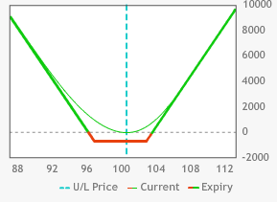
Long Strangles
Buy 10 PEP Dec103 calls @0.28
Buy 10 PEP Dec97 puts @0.44
PEP @100.12
Buy10 PEP strangles @0.72
Max upside profit unlimited
Max downside profit $96,280.00
Max loss $720.00
UBEP 103.72
DBEP 96.28

Slide 16
Short Strangles
Sell equidistant OTM calls & puts
Potentially become long or short the UV
Upside risk is unlimited & downside risk increases continuously until UV hits zero
Maximum possible profit is limited to the premium credited
Time value embedded in option premium is constantly decaying
In times of uncertainty time value can actually increase with the passage of time

Slide 17
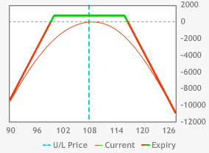
Short Strangles
Sell 10 GILD Dec 116 calls @0.24
Sell 10 GILD Dec 100 puts @0.52
GILD @107.69
Sell 10 GILD strangles @0.76
Max profit $760.00
Max downside loss $99,240.00
Max upside loss unlimited
UBEP 116.76
DBEP 99.24

Slide 18
Covered Calls
Call is written against stock on a share for share basis
500 shares of long stock would have 5 calls written against the stock
5 long futures contracts would have 5 calls written against the futures
Used as an income generation strategy
Also referred to as a buy-write strategy
Behaves the same as a short put

Slide 19
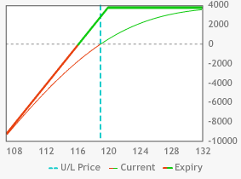
Covered Calls
Existing long position 1K shares @119.03
Sell 10 AAPL Jan 120 calls @2.77
Max profit $3,740.00
Max loss $116,260.00 @zero

Slide 20
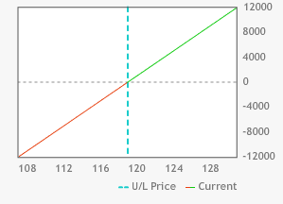
Long Stock Before Covered Call
Long 1,000 shares AAPL @ 119.03
Max loss $119,030.00 @zero
Max profit unlimited

Slide 21
Covered Calls vs. Short Puts
Sell 10 AAPL Jan 120 puts @3.70
Max loss 116,300.00 @zero

Slide 22
Protective Puts
Risk management strategy where an OTM put is bought against an existing long position in the UV to protect against a decline in the UV price
Can potentially reduce the rate of return on long position in UV
Behaves the same way as a long call

Slide 23
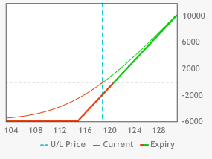
Protective Puts
Buy 1,000 shares AAPL @ 119.03
Buy 10 AAPL Jan 115 puts @1.79
Max profit unlimited
Max loss $5,820.00 @115 or lower

Slide 24
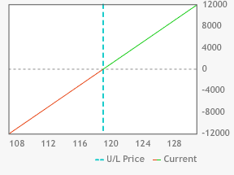
Long Stock Before Protective Put
Buy 1,000 shares AAPL @ 119.03
Max loss $119,030.00 @zero
Max profit unlimited

Slide 25
Long Call vs. Protective Put
Buy 10 AAPL Jan 115 calls @ 5.85
Max loss $5,850 @115 or lower

Slide 26
Long Synthetic Puts
Risk management strategy where an OTM call is bought against an existing short position in the UV to protect against an increase in the UV price
Can potentially reduce the rate of return on short position in UV
Behaves the same way as a long put

Slide 27
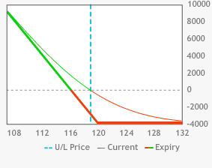
Long Synthetic Put
Buy 10 AAPL Jan 120 calls @2.82
Sell 1,000 shares @119.03
Max profit $116,210.00
Max loss $3,790.00 @120 or higher

Slide 28
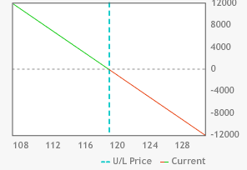
Short AAPL Stock Before Long Call

Slide 29
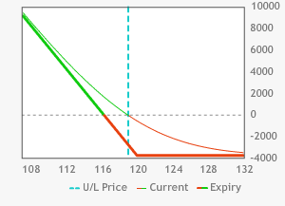
Long Synthetic Put vs. Long Put
Buy 10 AAPL Jan 120puts @ 3.75
Max loss $3,750

Slide 30
Synthetic Short Calls
Puts are written against short stock on a share for share basis
500 shares of short stock would have 5 puts written against the stock
5 short futures contracts would have 5 puts written against the futures
Used as an income generation strategy
Behaves the same as a short call

Slide 31
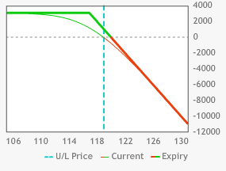
Synthetic Short Call
Short 1,000 shares AAPL @119.03
Sell 10 AAPL Dec 117 puts @1.05
Max profit $3,080.00 @117 or lower
Max loss unlimited to the upside

Slide 32

Short Shares Before Short Puts
Short 1,000 shares@ 119.03
Max loss unlimited
Max profit $119,030.00

Slide 33
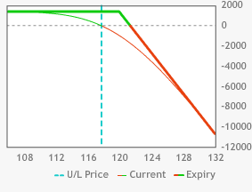
Short Call vs. Short Synthetic Call
Sell 10 AAPL Dec 120 calls @3.05
Max profit $3,050.00 @117 or lower

Slide 34
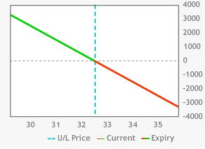
Synthetic Short Stock
Sell 10 PFE Dec 32.50 calls @ 0.45
Buy 10 PFE Dec 32.50 puts @ 0.42
Synthetically short stock @32.53

Slide 35
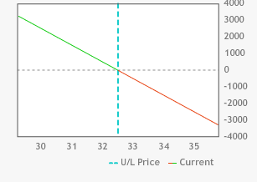
Synthetic Short Stock vs. Short Stock
Short 1,000 shares PFE @32.53

Slide 36
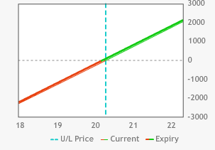
Synthetic Long Stock
Sell 10 GPRO Dec20 puts @1.35
Buy 10 GPRO Dec20 calls @ 1.56
Synthetically long 1,000 share GPRO @20.21

Slide 37
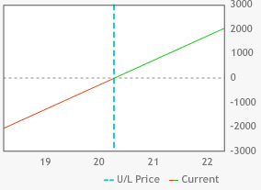
Synthetic Long Stock vs. Long Stock
Long 1,000 shares GPRO @20.23

Slide 38
Quiz
1) When you buy 5 AAPL Dec 119 calls @1.41 & sell 500 AAPL shares @119.00 you have created a
short synthetic call
long synthetic put
short synthetic put
long synthetic call

Slide 39
Quiz
2) What premium, excluding dividends & interest did you pay in Question #1?
1.41
0.72
2.85
2.13

Slide 40
Quiz
3) What is the max profit for the trade in Question #1?
2.85
119.03
117.59
2.13

Slide 41
Quiz
4) What is the max loss for the trade in Question #1?
1.41
119.03
117.87
2.13

Slide 42
Quiz
5) What is the breakeven point for the trade in Question #1?
115.05
117.59
116.87
121.16

Slide 43
Quiz
6) When you sell 5 FB Dec 107 calls @1.25 & buy 500 FB shares @105.61 you have created a
short synthetic call
long synthetic put
short synthetic put
long synthetic call

Slide 44
Quiz
7) What is the premium, excluding dividends & interest did in Question #6?
2.64
1.25
5.61
2.13

Slide 45
Quiz
8) What is the max profit for the trade in Question #6?
2.64
1.25
5.61
2.13

Slide 46
Quiz
9) What is the max loss for the trade in Question #6?
2.85
119.03
104.36
2.13

Slide 47
Quiz
10) What is the breakeven point for the trade in Question #6?
115.05
119.03
11,05
104.36

Slide 48
Quiz
11) When you sell 5 TWTR Jan 23 puts @0.83 & sell 500 TWTR shares @24.50 you have created a
short synthetic call
song synthetic put
short synthetic put
long synthetic call

Slide 49
Quiz
12) What is the premium, excluding dividends & interest did in Question #11
2.33
4.01
2.13
4.15

Slide 50
Quiz
13) What is the max profit for the trade in Question #11?
unlimited
21.25
5.61
2.33

Slide 51
Quiz
14) What is the max loss for the trade in Question #11?
2.85
unlimited
104.64
2.33

Slide 52
Quiz
15) What is the breakeven point for the trade in Question #11?
25.33
24.50
23.50
26.38

Slide 53
Quiz
16) When you buy 4 NFLX Jan 120 puts @5.50 & buy 400 NFLX shares @125.36 you have created a
short synthetic call
song synthetic put
short synthetic put
long synthetic call

Slide 54
Quiz
17) What is the premium, excluding dividends & interest did in Question #16?
5.36
5.50
10.86
2.13

Slide 55
Quiz
18) What is the max profit for the trade in Question #16?
unlimited
21.25
10.86
2.33

Slide 56
Quiz
19) What is the max loss for the trade in Question #16?
21.25
unlimited
10.86
2.33

Slide 57
Quiz
20) What is the breakeven point for the trade in Question #16?
115.05
119.03
130.86
104.64

Slide 58
Quiz
21) When you sell AAPL Dec 118 straddle @3.61 the max profit is
1.95
1.66
3.61
114.39

Slide 59
Quiz
22) When you sell AAPL Dec 118 straddle @3.61 the max downside loss is
unlimited
18.66
3.61
114.39

Slide 60
Quiz
23) When you sell AAPL Dec 118 straddle @3.61 the max upside loss is
unlimited
18.66
3.61
114.39

Slide 61
Quiz
24) When you sell AAPL Dec 118 straddle @3.61 the UBEP is
32.97
18.66
121.61
114.39

Slide 62
Quiz
25) When you sell AAPL Dec 118 straddle @3.61 the DBEP is
32.97
18.66
121.61
114.39

Slide 63
Quiz
26) When you buy SLB Dec 72.50 straddle @3.30 the max upside profit is
69.20
1.66
3.30
unlimited

Slide 64
Quiz
27) When you buy SLB Dec 72.50 straddle @3.30 the max downside profit is
69.20
1.66
3.30
unlimited

Slide 65
Quiz
28) When you buy SLB Dec 72.50 straddle @3.30 the max loss is
69.20
1.66
3.30
unlimited

Slide 66
Quiz
29) When you buy SLB Dec 72.50 straddle @3.30 the UBEP is
69.20
75.80
3.30
65.90

Slide 67
Quiz
30) When you buy SLB Dec 72.50 straddle @3.30 the DBEP is
69.20
75.80
3.30
65.90

Slide 68
Quiz
31) When you buy XOM Feb 70 put – Feb 85 call strangle @2.33 the max upside profit is
15.00
67.67
65.90
unlimited

Slide 69
Quiz
32) When you buy XOM Feb 70 put – Feb 85 call strangle @2.33 the max downside profit is
15.00
67.67
65.90
unlimited

Slide 70
Quiz
33) When you buy XOM Feb 70 put – Feb 85 call strangle @2.33 the max loss is
1.65
0.68
2.33
unlimited

Slide 71
Quiz
34) When you buy XOM Feb 70 put – Feb 85 call strangle @2.33 the DBEP
94.20
77.50
87.33
67.67

Slide 72
Quiz
35) When you buy XOM Feb 70 put – Feb 85 call strangle @2.33 the UBEP
94.20
77.50
87.33
67.67

Slide 73
Quiz
36) When you sell PEP Jan 95 put – Jan 105 call strangle @0.78 the max downside loss is
97.50
100.00
94.22
unlimited

Slide 74
Quiz
37) When you sell PEP Jan 95 put – Jan 105 call strangle @0.78 the max upside loss is
97.50
94.28
100.00
unlimited

Slide 75
Quiz
38) When you sell PEP Jan 95 put – Jan 105 call strangle @0.78 the UBEP is
95.41
94.28
105.78
101.20

Slide 76
Quiz
39) When you sell PEP Jan 95 put – Jan 105 call strangle @0.78 the DBEP is
95.41
94.22
105.78
101.20

